Slide 1


Introduction to Circuits Analysis
by Andrew G. Bell
abell118@ivytech.edu
(260) 481-2288
Lecture 5

Slide 2
CHAPTER 5
Parallel Circuits

Slide 3
Parallel Circuit Characteristics
There are two or more paths for current flow
The voltage is the same across all parallel branches

Slide 4
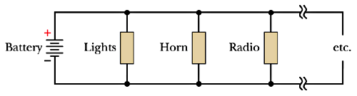
A Practical Example

Slide 5
Parallel Circuit Nodes
Two types of nodes or connections:
Dividing Node: A junction where current enters by one connection but leaves by two or more connections
Summing Connection: A junction where current enters a junction by two or more connections but leaves via one

Slide 6
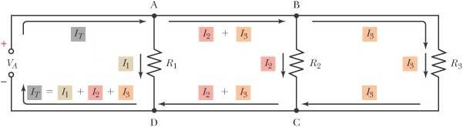
Parallel Circuit Nodes (cont.)

Slide 7
Parallel Circuit Current
All branch currents are supplied by the power supply.
Current leaving the (–) terminal is the same current entering the (+) terminal.
This is referred to as total current (I_{T}).
The total current equals the sum of the branch currents.

Slide 8
Parallel Circuit Current (cont.)
Since the total current is equal to the current supplied by the source, the total current can be stated as:
I_{T} = I_{R1} + I_{R2} … + I_{Rn}

Slide 9
Kirchhoff’s Current Law
Kirchhoff’s current law states that the sum of the currents entering a junction must be equal to the sum of the currents leaving the junction:
I_{in} = I_{out}

Slide 10
Current in a Parallel Circuit
If the applied voltage (and, therefore, the voltage across each branch) and the branch resistance are known, the current through each branch can be found by using Ohm’s law.
The branch with the least resistance has the most current.

Slide 11
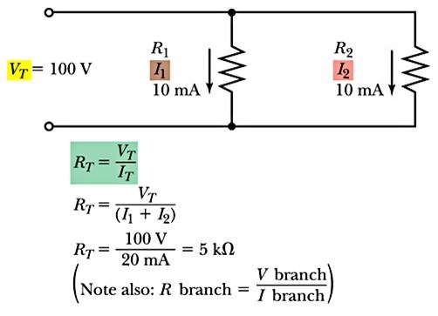
Total Resistance
Ohm’s law method:

Slide 12
Conductance Method

Slide 13
Product-Over-The-Sum Method
This works for a circuit with only two resistors in parallel:

Slide 14
Equal Value Branches
Where R_{x} is the value of the branch resistance and N is the number of branches

Slide 15
Reciprocal Method
This works for a circuit with any number of resistors in parallel:

Slide 16
Assumed Voltage Method
Assume a supply voltage (V_{T})
Calculate all branch currents
Add branch currents to find I_{T}
Find R_{T} by applying Ohm’s law:

Slide 17
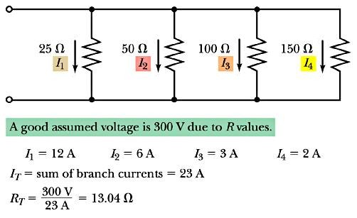
Example

Slide 18
Total Resistance
Important Concept
The total resistance of parallel circuits is always less than the smallest value branch resistance.

Slide 19
Power in Parallel Circuits
Summation method
P_{T} = P_{R1} + P_{R2} … + P_{Rn}
Ohm’s law method

Slide 20
Opens in Parallel Circuits
If a branch opens, the current goes to zero in that branch.
If the total current decreases, the total resistance increases.
Branch voltage remains the same across the open branch and the other branches.

Slide 21
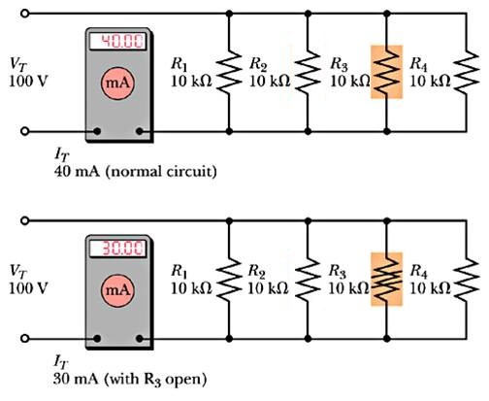
A Practical Example

Slide 22
Shorts in Parallel Circuits
Remember: There are 0Ω across a short.
The branch resistance goes to 0Ω; thus, the total resistance goes to 0Ω.
Since there are 0Ω across the branches, no voltage drop is developed.
A protective device is required because current is maximized.

Slide 23
Contrasting Series and Parallel Circuits
SERIES
I_{T} is constant
KVL is used
V_{T} = sum of drops
R_{T} = sum of resistors
PARALLEL
I_{T} is the sum of I_{Rn}
KCL is used
V_{T} is constant
R_{T} is reciprocal of the sum of the reciprocals

Slide 24
Voltage Sources in Parallel
Sources are used in parallel to increase the amount of total current available.
While V_{T} remains the same, I_{T} increases by the amount of each source.

Slide 25
Current Dividers in a Two-Branch Circuit

Slide 26
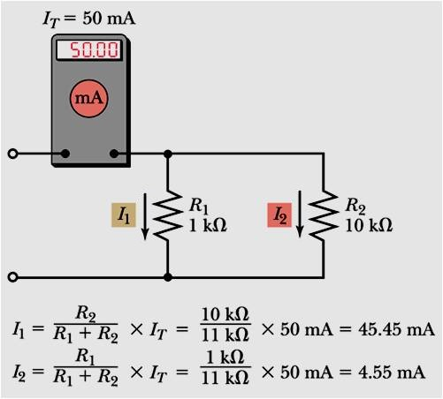
Current Dividers in a Two-Branch Circuit (cont.)

Slide 27
Current Dividers in a Two-Branch Circuit (cont.)

